Slide 1


DEPARTMENT OF COMPUTER SCIENCE AND ENGINEERING
Project name : Smart India Restroom
Team name : Proj_224780_Team_2
Team members : MOHITHA LAKSHMI N S (113321104062)
MONIKA D (113321104063) NAGALAKSHMI M (113321104064) NAIDU K SUJITHA S KUMAR (113321104065)

Slide 2
PROJECT
Building a smart public restroom using IoT involves various components and technologies. Below, I'll provide you with a high-level Python code example for a simplified smart public restroom system. Keep in mind that this is a basic example, and a real-world implementation would require more robust hardware, sensors, and a backend system for managing data.

Slide 3
Innovation:
Smart public restrooms can greatly enhance user experience and hygiene. Here are some innovative ideas
Automated Cleaning: Incorporate sensors and
robotics to automatically clean and disinfect
restroom fixtures and floors, reducing the need for
human intervention.
Touchless Fixtures: Use touchless faucets, soap dispensers, and flush mechanisms to minimize germ transmission.
Energy Efficiency: Utilize smart lighting and HVAC systems that adjust based on occupancy to save energy

Slide 4
Requirements:
The Components that are required are:
1.Raspberry Pi (or any other IoT device)
2.Sensors (e.g., occupancy sensor, door sensor, ultrasonic sensor)
3.IoT Platform (e.g., ThingSpeak for data visualization)
4.Actuators (e.g., LED lights, fans)
5.Relay module for controlling actuators
6.Internet connectivity

Slide 5
PROJECT OBJECTIVE
Building a smart public restroom using IoT involves various components and technologies.
Below, I'll provide you with a high level Python code example for a simplified smart public restroom system.
Keep in mind that this is a basic example, and real-world implementation would require more robust hardware, sensors, and a backend system for managing data.
Now a days the smart Restroom is essential More in Hitech city and more are comfortable with this.

Slide 6
RASPBERRY PI INTEGRATION:
Our proposed system is a smart
monitoring system designed to monitor the hygiene of public toilets. Unhygienic toilets can be detected by different parameters such as water levels, and various gases evolved, humidity. temperature etc. Ammonia gas is the most dominant gas that can be sensed in an unhygienic toilet. We will be using the MQ-135 gas sensor the determine the amount of ammonia present in the room

Slide 7
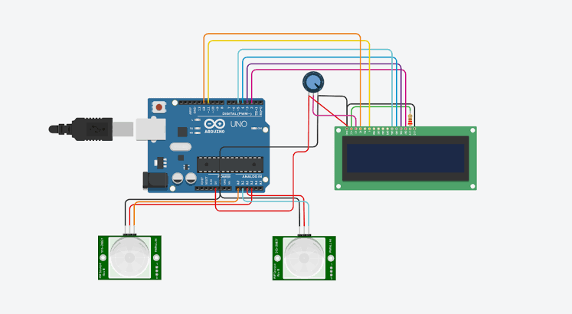
Arduino integration :

Slide 8
PLATFORM REQUIRED:
Data analysis platform: Through the data collected by smart gateways and smart controllers, a data analysis platform is established to analyze and process public toilet usage data, sanitation data, and energy consumption data, providing city managers with more scientific decision-making basis.
Intelligent management: Through the intelligent gateway and intelligent controller, realize the intelligent management of public toilets, including real-time monitoring, remote control, real-time data analysis of public toilets, etc., to improve the management efficiency and service quality of public toilets.

Slide 9
WEB DEVELOPMENT TECHNOLOGIES:
•Front-End: You can use HTML, CSS, and JavaScript for creating a web based dashboard or user interface. Frameworks like React, Angular, or Vue.js can simplify the development process
•Back-End: You might need a server to handle data processing, user authentication, and other backend functionalities. You can use Node.js, Python, Ruby, or any other server side technology.
•Databases: Use databases (e.g., MySQL, PostgreSQL, MongoDB) to store and retrieve data.
•APIs: Create APIs to connect the front-end and back-end. RESTful or GraphQL APIs are common choices.

Slide 10
code implementation:
Hardware Components:
Wi-Fi Module (for internet connectivity) Power Supply 00000
Raspberry Pi (or similar single-board computer)
Water Flow Sensor
Solenoid Valve (for controlling water flow)
Software Components:
Python (for programming) MQTT (for communication)
•cloud server (for data storage and remote control)

Slide 11
PYTHON CODE
import RPi.GPIO as GPIO
import time
import requests
# Set up GPIO pins
OCCUPANCY_SENSOR_PIN = 18
DOOR_SENSOR_PIN = 23
ULTRASONIC_TRIGGER_PIN = 24
ULTRASONIC_ECHO_PIN = 25
GPIO.setmode(GPIO.BCM)
GPIO.setup(OCCUPANCY_SENSOR_PIN, GPIO.IN)
GPIO.setup(DOOR_SENSOR_PIN, GPIO.IN)
GPIO.setup(ULTRASONIC_TRIGGER_PIN, GPIO.OUT)
GPIO.setup(ULTRASONIC_ECHO_PIN, GPIO.IN)

Slide 12
# Function to read ultrasonic sensor
def read_ultrasonic_sensor():
GPIO.output(ULTRASONIC_TRIGGER_PIN, True)
time.sleep(0.00001)
GPIO.output(ULTRASONIC_TRIGGER_PIN, False)
pulse_start_time = time.time()
pulse_end_time = time.time()
while GPIO.input(ULTRASONIC_ECHO_PIN) == 0:
pulse_start_time = time.time()
while GPIO.input(ULTRASONIC_ECHO_PIN) == 1:
pulse_end_time = time.time()
pulse_duration = pulse_end_time - pulse_start_time
distance = (pulse_duration * 34300) / 2 # Speed of sound = 34300 cm/s
return distance

Slide 13
pulse_duration = pulse_end_time - pulse_start_time
distance = (pulse_duration * 34300) / 2 # Speed of sound = 34300 cm/s
return distance
# Function to send data to IoT platform
def send_data_to_iot(occupancy, door_status, distance):
url = "https://api.thingspeak.com/update"
params = {
"api_key": "YOUR_API_KEY",
"field1": occupancy,
"field2": door_status,
"field3": distance
}
response = requests.get(url, params=params)
print("Data sent to IoT platform:", response.text)
try:
while True:
occupancy = GPIO.input(OCCUPANCY_SENSOR_PIN)
door_status = GPIO.input(DOOR_SENSOR_PIN)
distance = read_ultrasonic_sensor()

Slide 14
# Control actuators based on sensor data
# For example, turn on lights and fans when occupancy is detected
if occupancy == 1:
# Activate actuators
GPIO.output(LED_PIN, GPIO.HIGH)
GPIO.output(FAN_PIN, GPIO.HIGH)
else:
# Deactivate actuators
GPIO.output(LED_PIN, GPIO.LOW)
GPIO.output(FAN_PIN, GPIO.LOW)
# Send data to the IoT platform
send_data_to_iot(occupancy, door_status, distance)
time.sleep(5) # Update data every 5 seconds
except KeyboardInterrupt:
GPIO.cleanup()

Slide 15
Smart Public Toilets Making Public toilet smart and hygienic:
USER COUNTER: The requirement is that sensor that can be mount on the head(top) of the door to count the user with reasonable accuracy.Also,it should be rigid enough to protect from vandalism.when a person passes beneath the PIR sensor which will be mounted on the head(top)of the Toilet it detects the motion of the person This gives a high pulse at the output.This pulse will remain High for a specific timeout and then become low for a certain time nad become ready again to detect another motion.

Slide 16
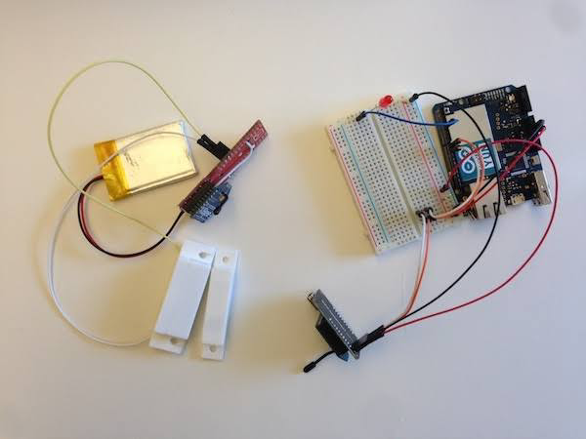
So, when motion is detected output goes HIGH for 2.7 – 2.9 seconds (approx.) and becomes LOW. Now, its output will not have LOW for the guaranteed period and will become ready to detect motion.

Slide 17
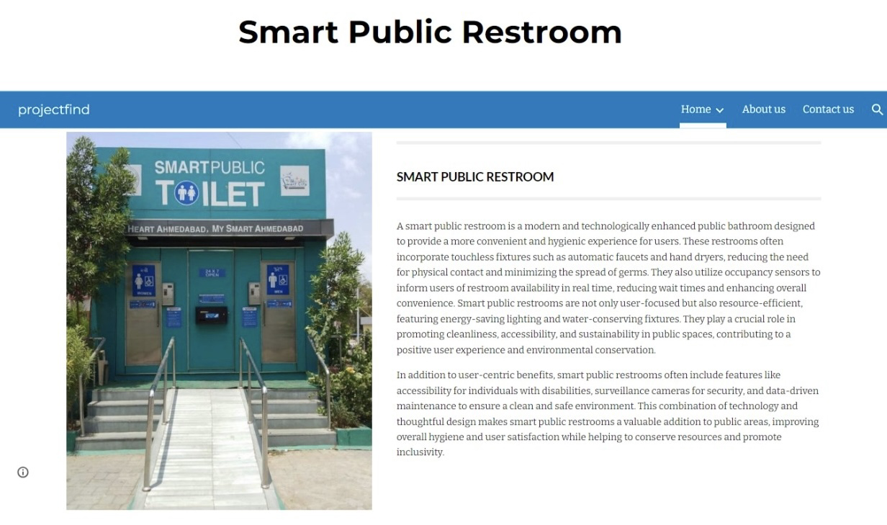
Click here to check our website

Slide 18
CONCLUSION
Smart restroom technology is transforming the way we experience public and private restrooms. With features like occupancy sensors, oder detection, and supply level monitoring, smart restrooms enhance hygiene, efficiency, and user satisfaction. The implementation of smart restroom management systems and monitoring systems streamlines operations, optimizes resource allocation, and ensures a safe and pleasant restroom experience.
As technology continues to evolve, the future of smart restrooms looks promising, with AI-powered systems, voice-activated controls, and blockchain-based solutions on the horizon. By embracing these advancements, facilities can create smart restrooms that meet the ever-changing needs and expectations of users.

Slide 19
THANK YOU

